Slide 1

Concrete Coast
KS4 Lessons

Slide 2
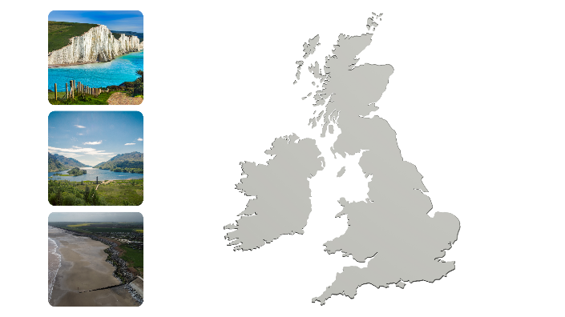
Coastal Topography & Relief Maps
What can you recognise?
Do you know where they are on the coast?

Slide 3

Coastal Topography & Relief Maps
Here are some hints. Now can you find them on the map?

Slide 4
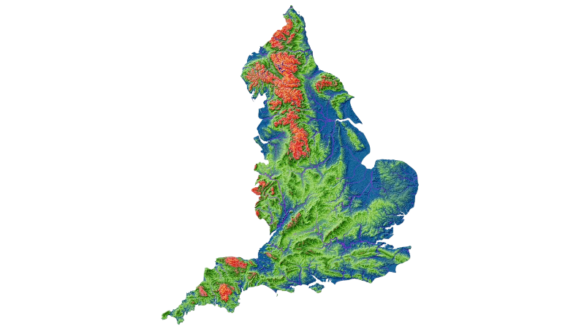
Coastal Topography & Relief Maps: Contour

Slide 5
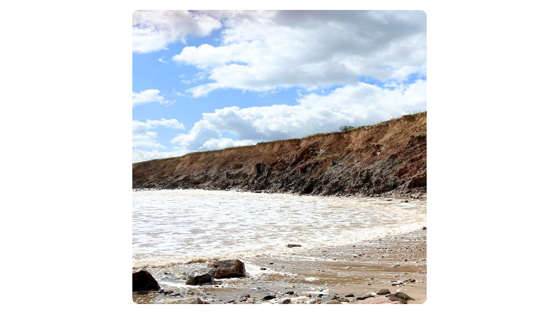
Coastal Topography & Relief Maps: Coastal Erosion

Slide 6
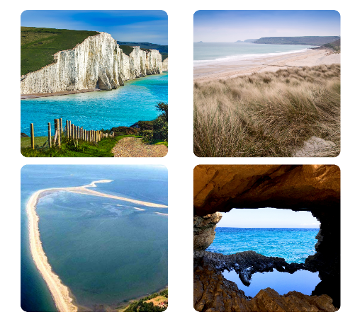
Coastal Landforms
Can you guess what each landform is?
Why it might have formed?

Slide 7
Coastal Landforms
Can you guess what each landform is?
Why it might have formed?
Word bank hints: cave, spit, beach, cliffs

Slide 8
Coastal Landforms: Cliffs

Slide 9
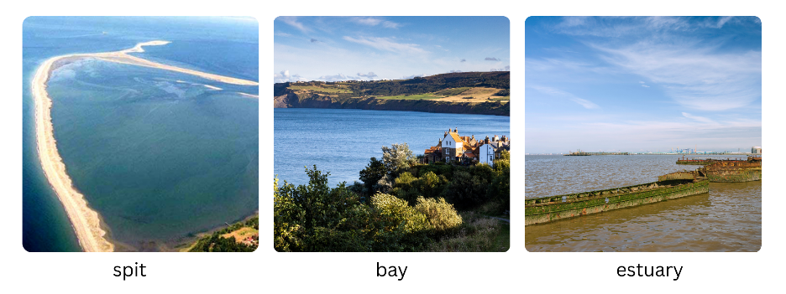
Coastal Landforms

Slide 10
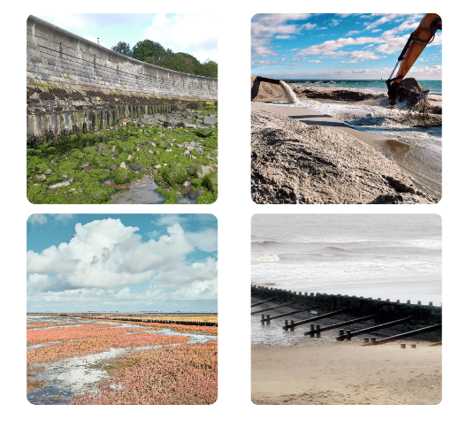
Coastal Management Strategies
Hard and soft management: Why do you think some defences are 'hard' and others 'soft'? What's the difference?

Slide 11
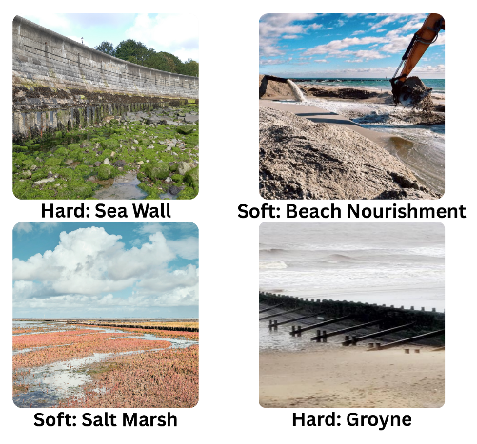
Coastal Management Strategies
Imagine you're a coastal manager.
A town is flooding. What would you build to protect it? Why?

Slide 12
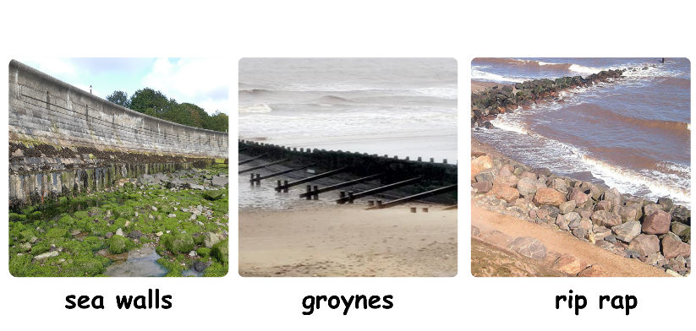
Coastal Management: Hard Engineering
Another hard engineering strategy: breakwater. What is it? How does it work?

Slide 13
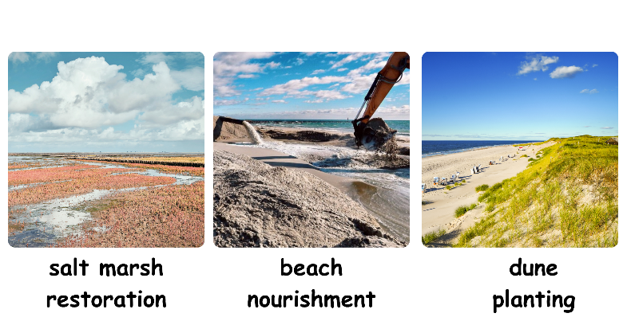
Coastal Management: Soft Engineering
Another soft engineering strategy: managed retreat. What is it? How does it work?

Slide 14
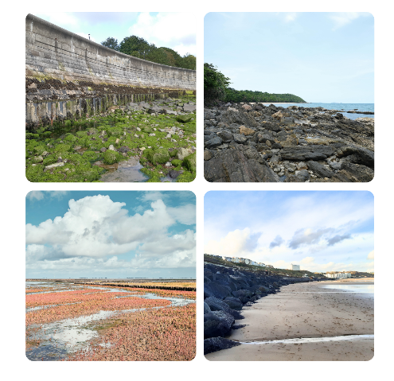
Man-Made versus Natural Habitats
Concrete sea wall, Rocky beach, Salt marsh, Sandy beach
Which has the most wildlife? Why?
What makes a good habitat for animals and plants?

Slide 15
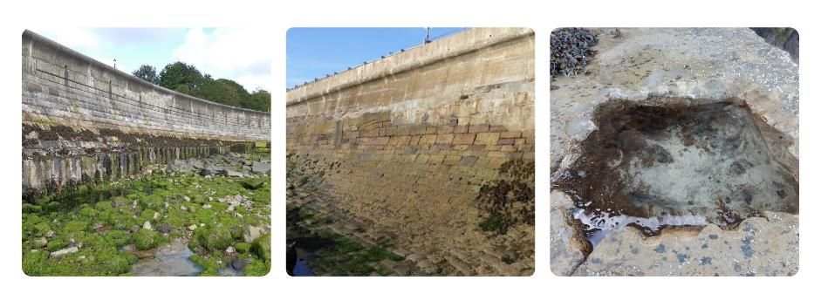
Man-Made Habitats

Slide 16
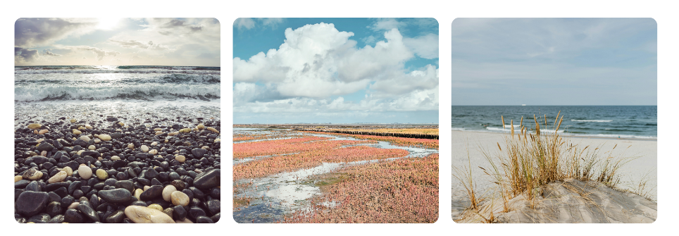
Natural Habitats

Slide 17
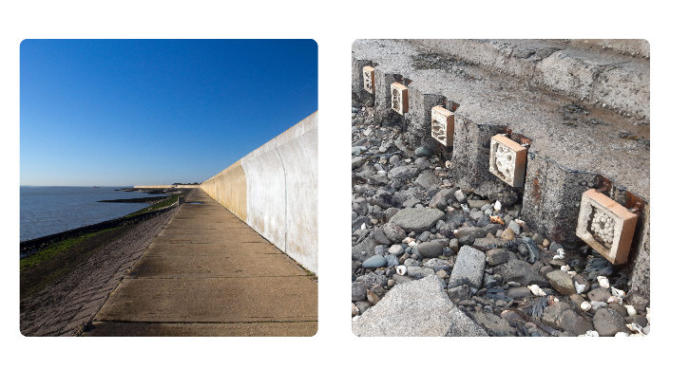
Ecological Enhancement and Design
Which protects people better?
Which is better for wildlife?
Can we have both?

Slide 18
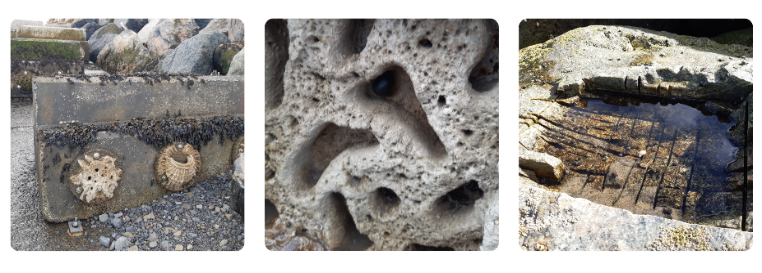
Ecological Enhancement and Design
Yorkshire’s Concrete Coast Case Study

Slide 19
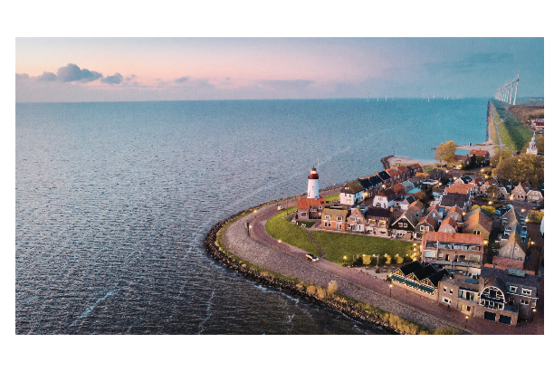
Critical Thinking
A town is eroding. 100 homes are at risk. The council has three options:
Hard engineering (£10M, protects everyone, harms wildlife)
Soft engineering (£2M, less effective, helps wildlife)
Managed retreat (£5M, moves people inland, creates nature reserve)
What would you choose? Why?"

