Slide 1
UK Coastal Habitats
KS3 Lessons

Slide 2
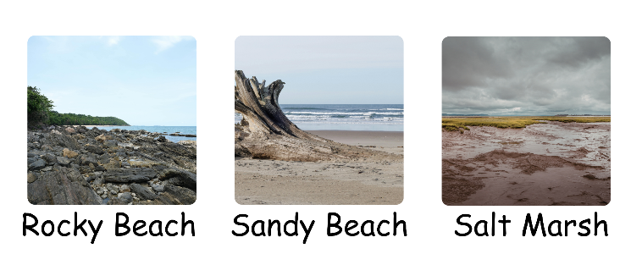
Coastline Features
What habitat would you like to live in? Why?
Which would you not like to live in? Why?

Slide 3
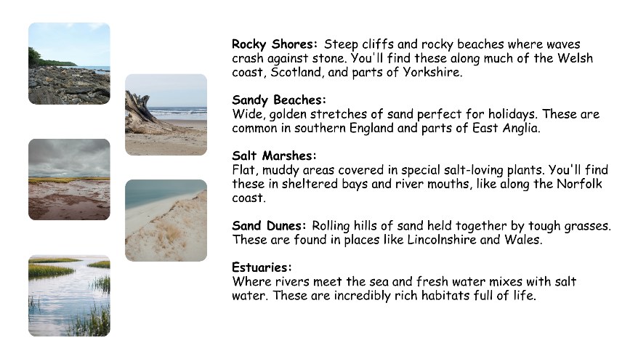
Coastal Habitats

Slide 4
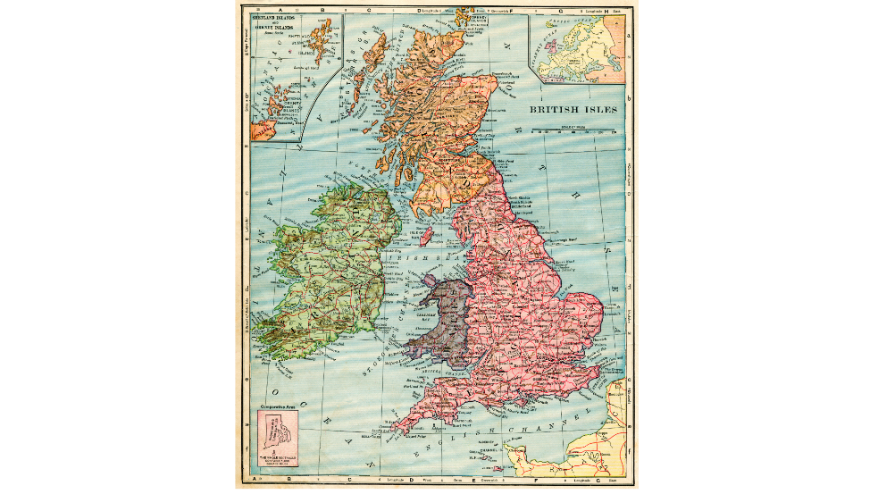
Our Nearest Coast: Where are we?

Slide 5
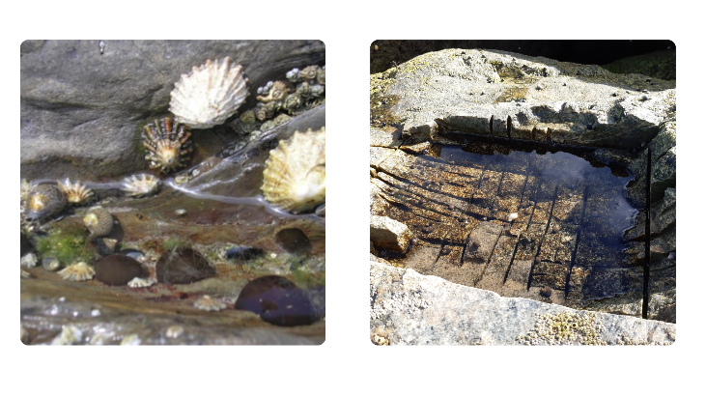
Rock Pools
What creatures can you spot?
How are they different from creatures in a pond?
Why would a rock pool be a tough place to live?

Slide 6
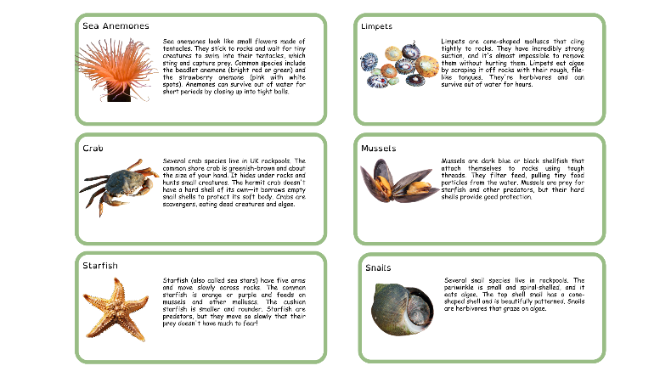
Rock Pools: Common Creatures

Slide 7
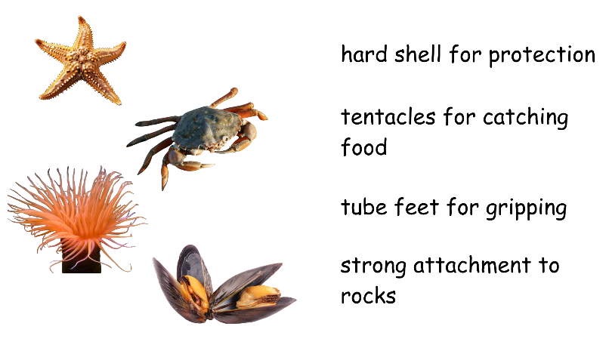
Rock Pools: Adaptations

Slide 8
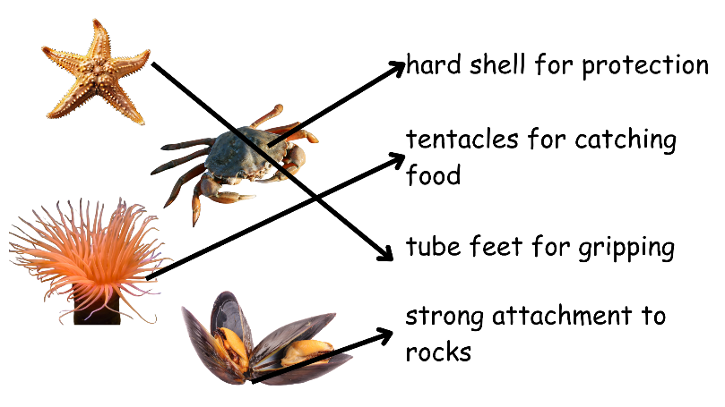
Rock Pools: Adaptations

Slide 9
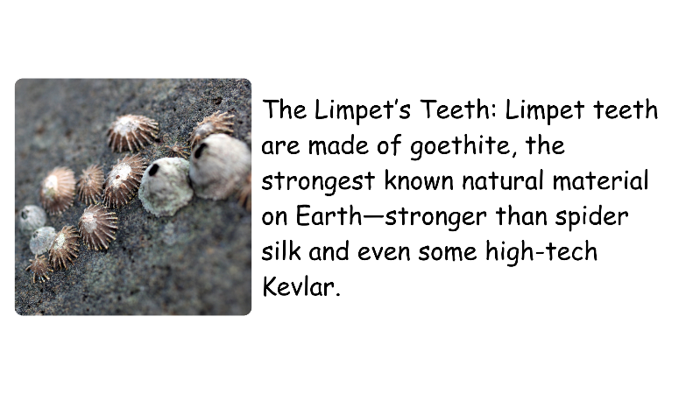
Rock Pools: Did you know?

Slide 10
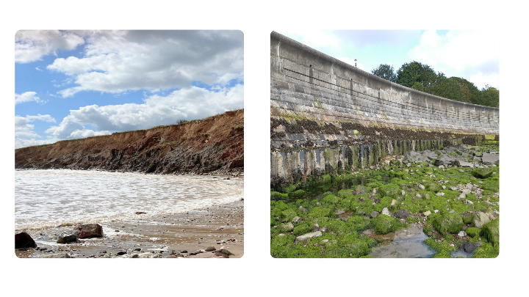
Humans Affecting Coastlines
What's different between these two images?
What has changed? Why?
How might creatures be affected by this change?

Slide 11
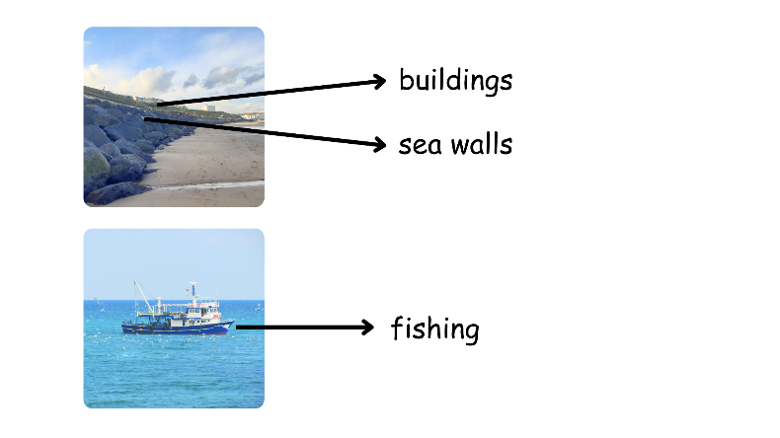
Humans & Coastlines

Slide 12
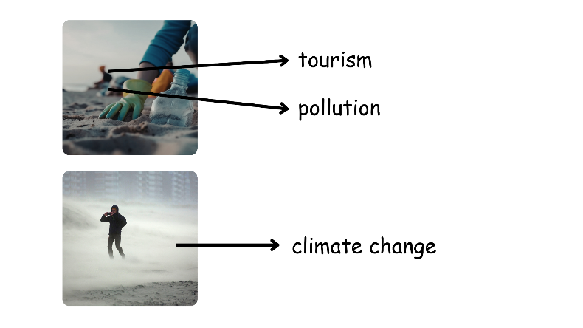
Humans & Coastlines

Slide 13
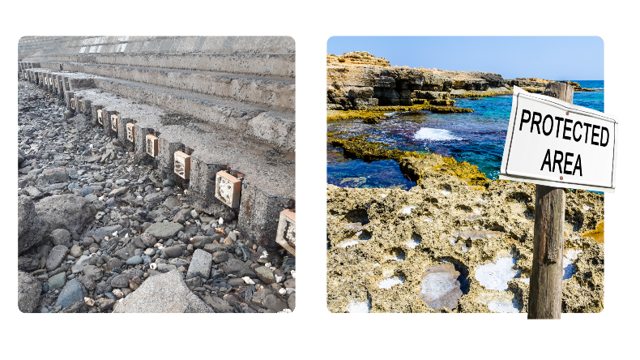
Humans & Coastlines

Slide 14

Humans & Coastlines: Your Area

Slide 15
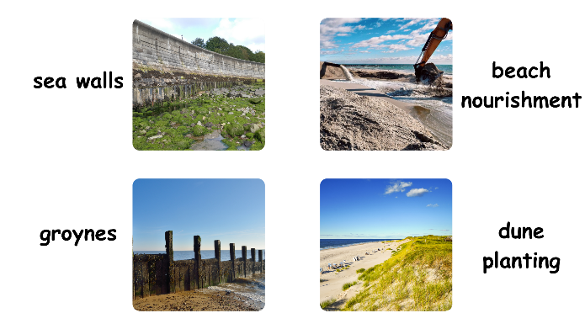
Coastal Defences
What's the difference between these structures?
Why would you use one instead of the other?"
Which looks more natural? Which looks stronger?

Slide 16
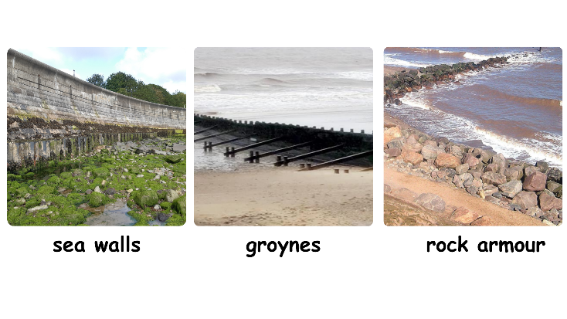
Coastal Defences: Hard Engineering

Slide 17
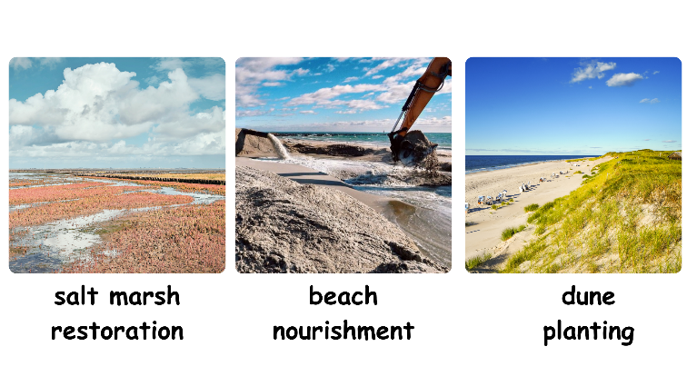
Coastal Defences: Soft Engineering

Slide 18
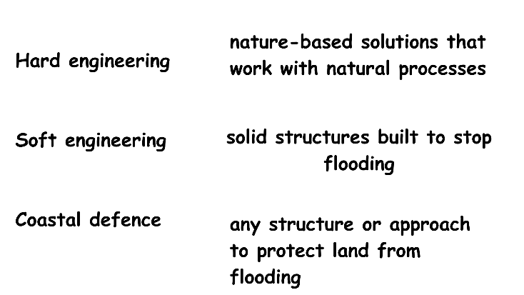
Coastal Defences

Slide 19
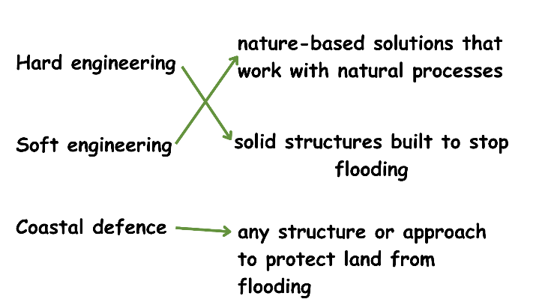
Coastal Defences

Slide 20
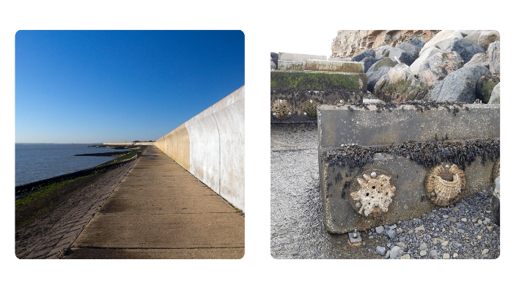
Eco-Engineering
What's the difference between the images?
Which one would creatures prefer? Why?
How could we make the bare wall better for wildlife?"

Slide 21
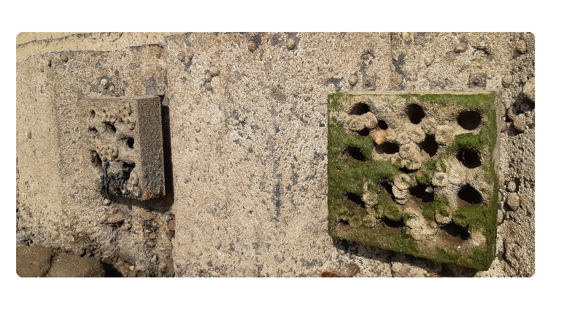
Eco-Engineering

Slide 22
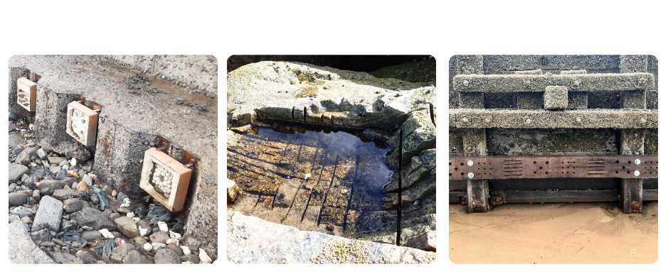
Eco-Engineering

