Slide 1
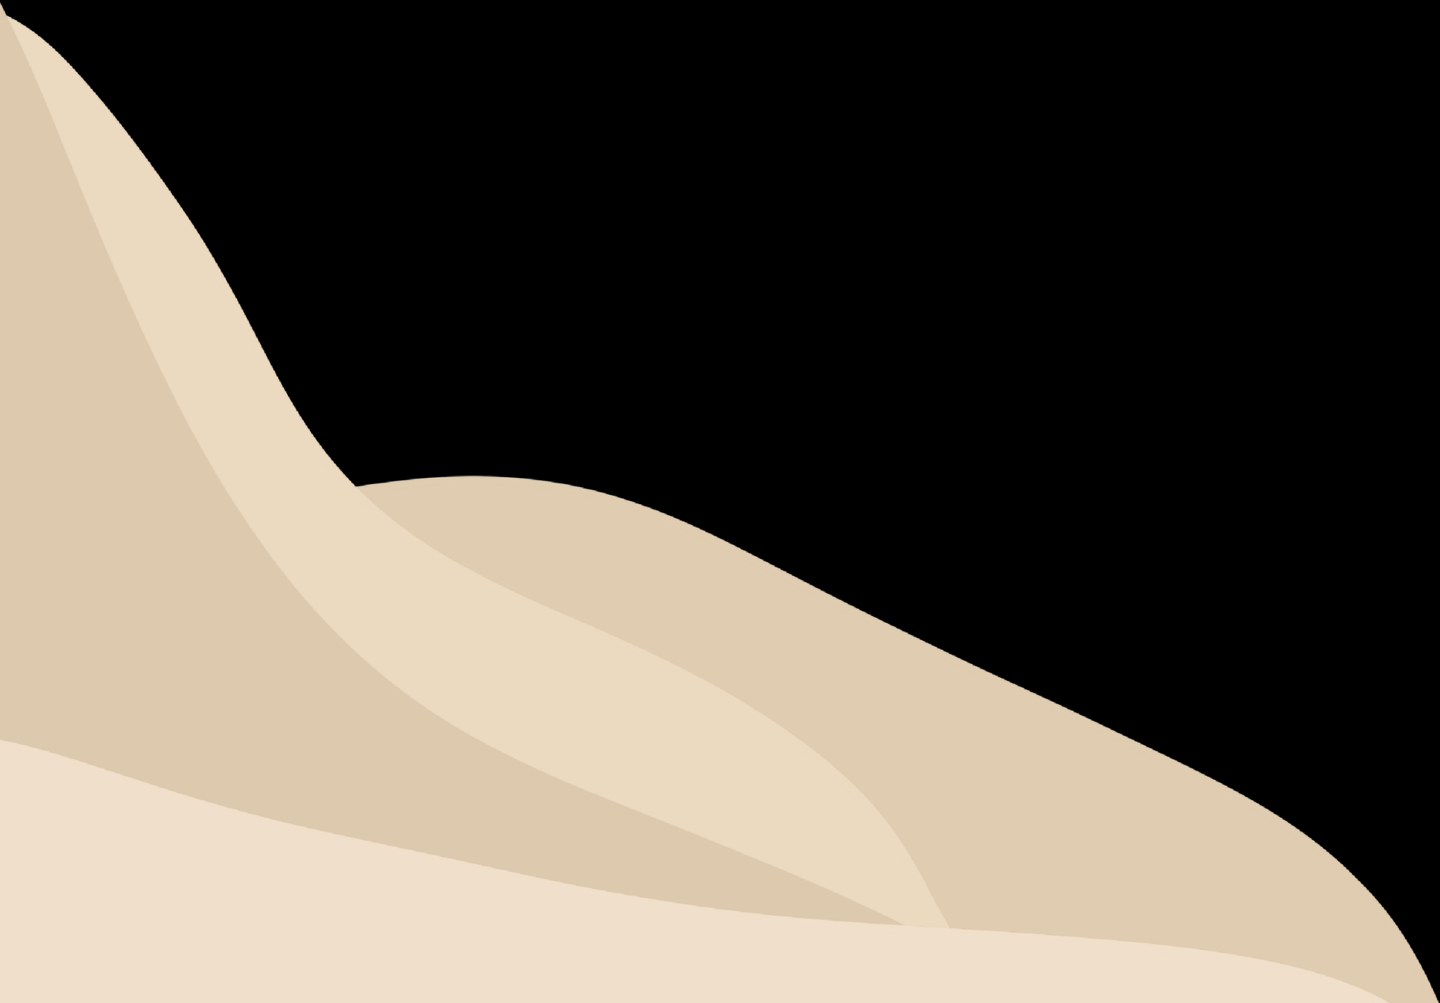




Changing Coasts
KS2 Lessons

Slide 2
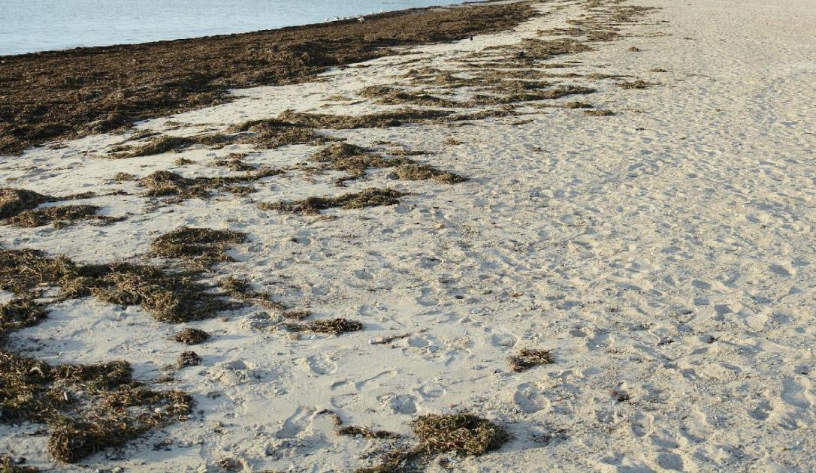
Coastal Habitats
Lesson 1
Discuss what you can see in each habitat.
What is the habitat like? (rocky, sandy, muddy, wet, dry, smooth, rough, sheltered, open)
What might live there?

Slide 3
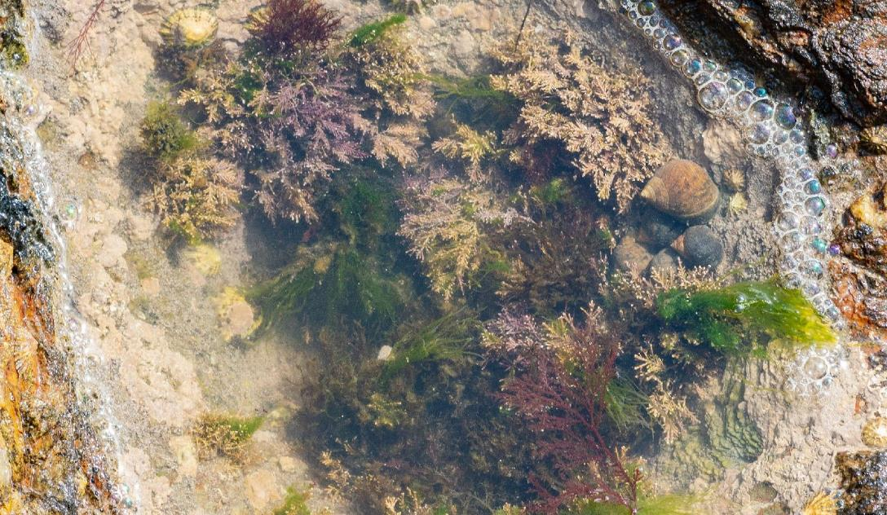
Coastal Habitats
Discuss what you can see in each habitat.
What is the habitat like? (rocky, sandy, muddy, wet, dry, smooth, rough, sheltered, open)
What might live there?

Slide 4
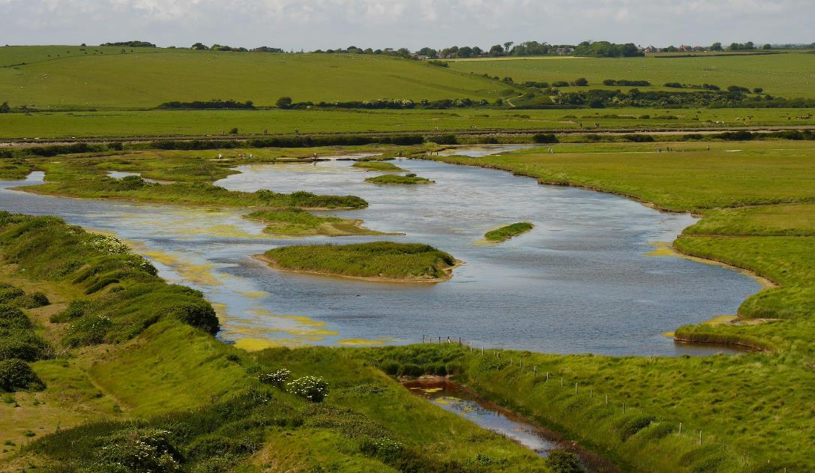
Coastal Habitats
Discuss what you can see in each habitat.
What is the habitat like? (rocky, sandy, muddy, wet, dry, smooth, rough, sheltered, open)
What might live there?

Slide 5
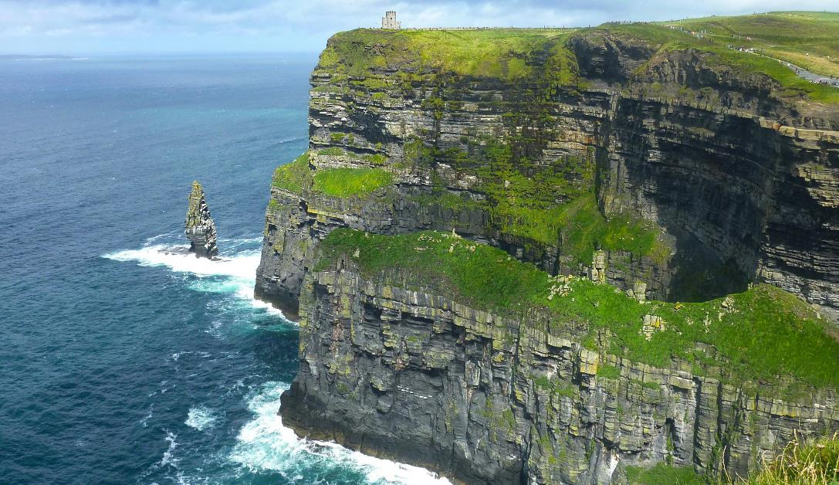
Coastal Habitats
Discuss what you can see in each habitat.
What is the habitat like? (rocky, sandy, muddy, wet, dry, smooth, rough, sheltered, open)
What might live there?

Slide 6
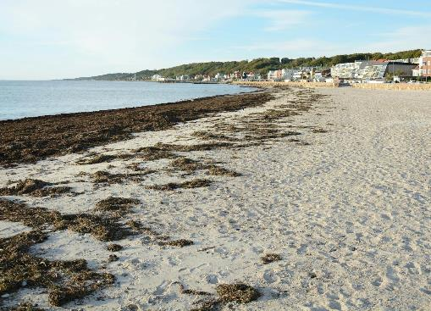
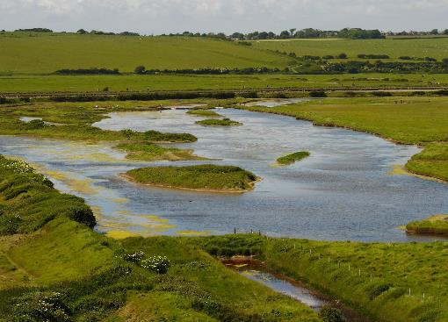
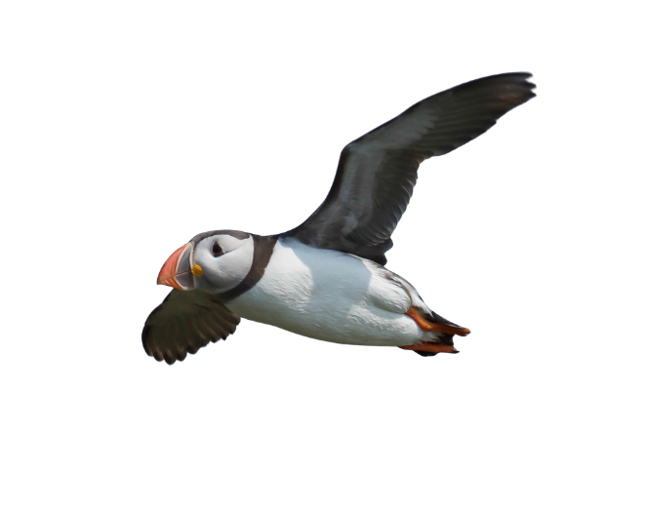
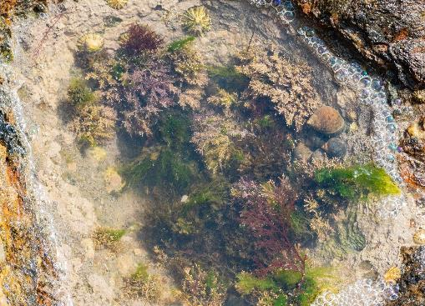
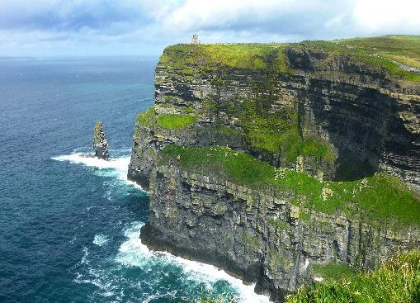
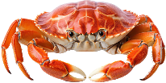
Why do you think different creatures live in different places?
sandy beach
saltmarsh
Which habitats would be suitable for the following animals?
Can you explain why?
puffin
rockpool
cliff
crab

Slide 7

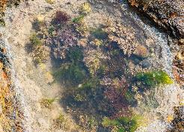
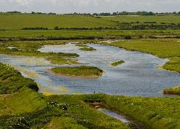
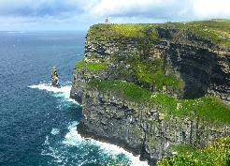
Habitat Exploration
sandy beach
Activity 1
In pairs or small groups.
Use your workbook pages about coastal habitats to find out more about one of the habitats.
  Describe the habitat (what it looks like, conditions like wet/dry/sheltered/open/sandy/rocky)
  List creatures that live there
Groups share what they have found out about their habitat.
rockpool
saltmarsh
cliff

Slide 8
Habitat Models
sandy beach
Activity 2
In pairs or small groups, create a simple model of the habitat you have researched.
For example:
  Cliff: stack pebbles and shells, create mound with soil
  Sandy beach: spread sand, add shells and pebbles
  Rockpool: arrange rocks and sand, and add water
  Saltmarsh: mix mud/sand and add water, arrange grass and small twigs
rockpool
saltmarsh
cliff

Slide 9
Coastal Habitats
sandy beach
saltmarsh
Which habitat do you think is the toughest place to live?
If you were a creature, which habitat would you choose to live in? Can you explain why?
rockpool
cliff

Slide 10
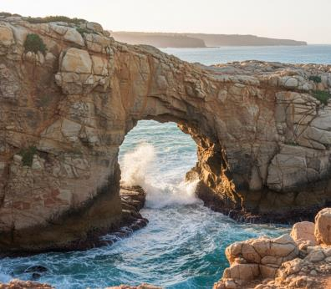
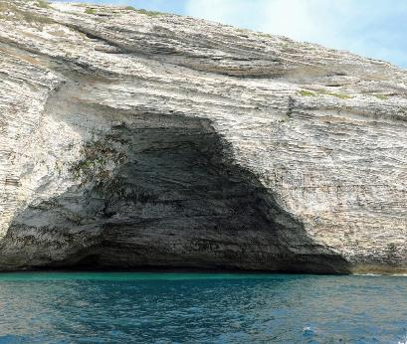
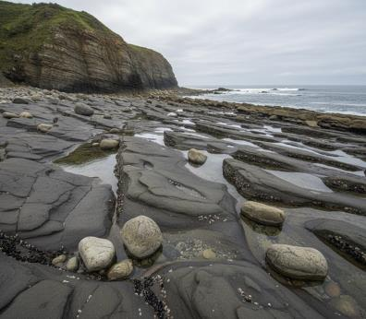
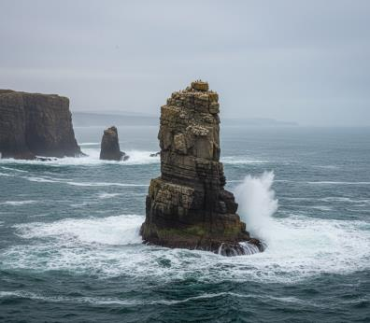
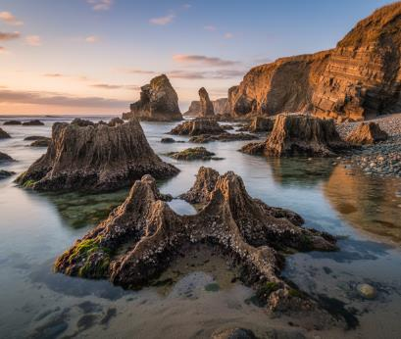
Cliff Landforms
Lesson 2
Here are some photographs of cliff formations.
How have they formed?
Can you sequence them into an order?

Slide 11
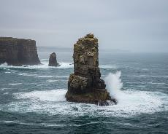
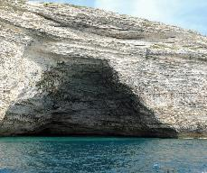
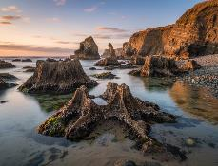
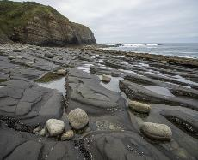
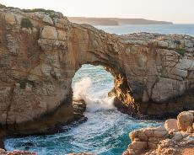
Cliff Landforms
Stack
Stacks are tall towers of rock left standing in the sea after an arch collapses.
Activity 1
Match the pictures to their
descriptions.
Stumps
Stumps are the short remains of stacks that have been worn down by waves over many years.
Cave
Caves form when waves wear away cracks in the rock, creating hollows in the cliff face.
Wave-cut platform
Wave-cut platforms are flat rocky areas at the base of a cliff where waves have worn away the softer rock.
Arch
Arches form when waves erode right through a headland, leaving a natural bridge of rock.

Slide 12
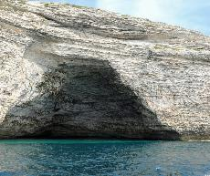
Cliff Landforms
Stack
Stacks are tall towers of rock left standing in the sea after an arch collapses.
Stumps
Stumps are the short remains of stacks that have been worn down by waves over many years.
Cave
Caves form when waves wear away cracks in the rock, creating hollows in the cliff face.
Wave-cut platform
Wave-cut platforms are flat rocky areas at the base of a cliff where waves have worn away the softer rock.
Arch
Arches form when waves erode right through a headland, leaving a natural bridge of rock.

Slide 13
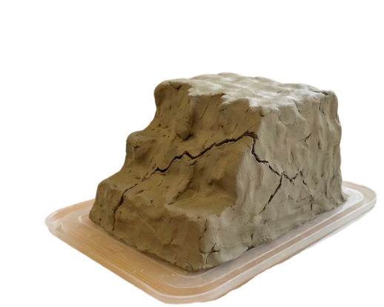
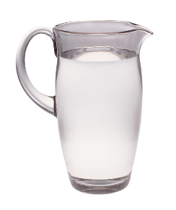

Cliff Model
Activity 2
Make a clay model and simulate erosion.
  Roll clay into a cliff shape.
  Use a stick or your finger to create a weak line (like a crack).
  Once dry, slowly ‘wear away’ the clay with water and rubbing it with a stick.

Slide 14
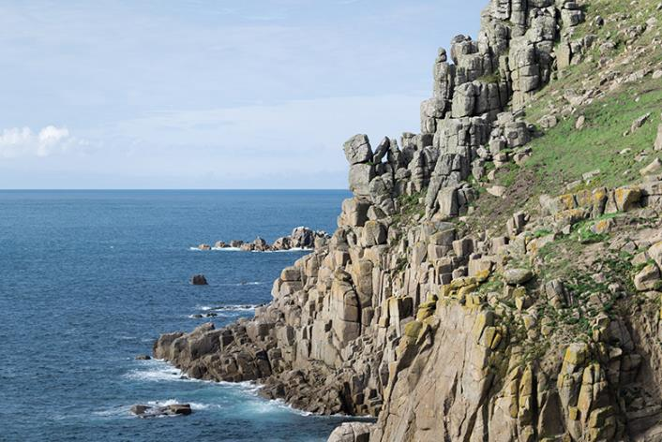
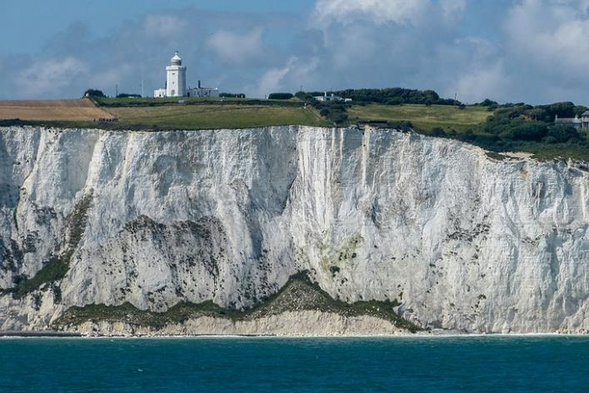
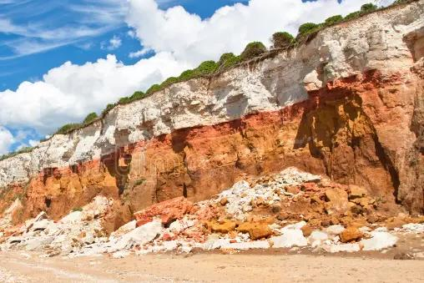
Cliff Landforms
Which cliff might be the youngest?
Which might be the oldest?
How did you decide?

Slide 15
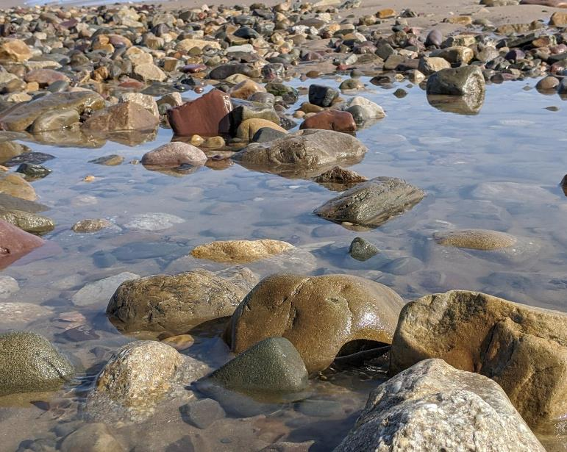
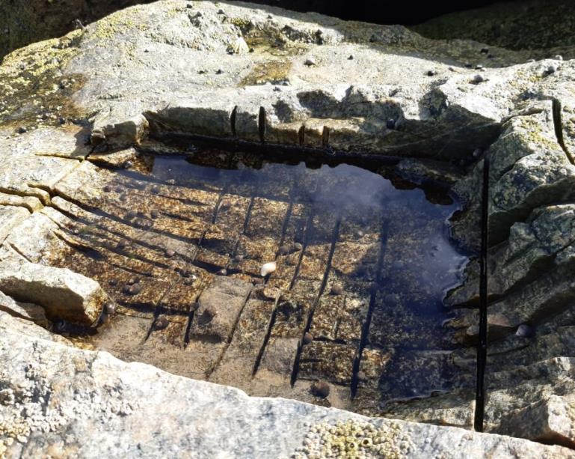
Natural and Human-made Habitats
Lesson 3
What’s the same about these two places?
What’s different about these two places?

Slide 16
Natural and Human-made Habitats
Which one is human made?
Why do you think it has been made?

Slide 17
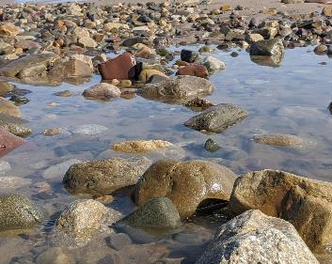

Natural and Human-made Habitats
Activity 1 Together we are going to compare both types of rockpool.
Natural
Human-made
e.g. formed by waves, weather and time
e.g. creatures must adapt to new conditions

Slide 18

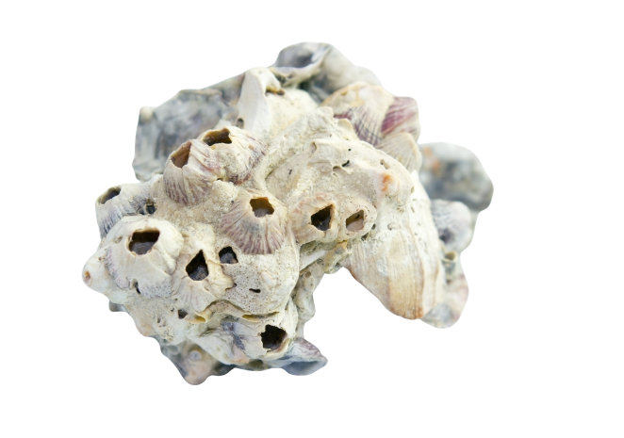
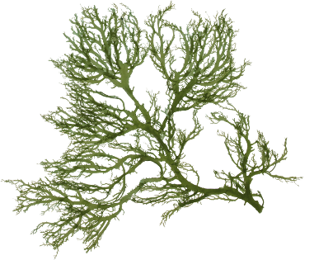
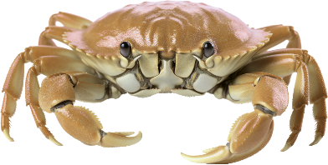
Concrete Coast Project
read together
The Concrete Coast project works along the Yorkshire coastline to make existing concrete sea defences better for wildlife. Scientists and engineers add special tiles and panels to sea walls and harbour walls. These tiles have holes, grooves, and pools that copy natural rock pools. Creatures like barnacles, limpets, mussels, periwinkles, shore crabs and seaweed can now live on the concrete walls, just like they would on natural rocks.

Slide 19
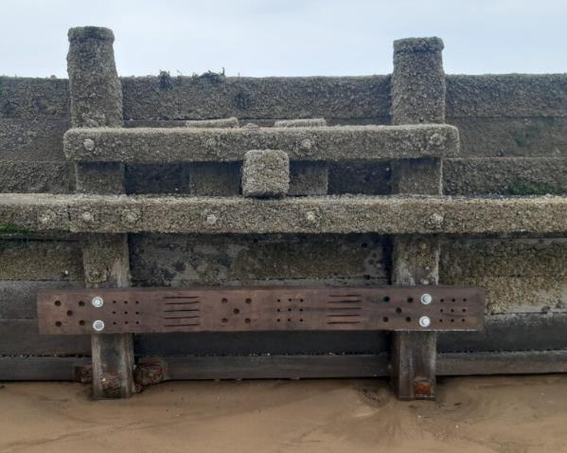
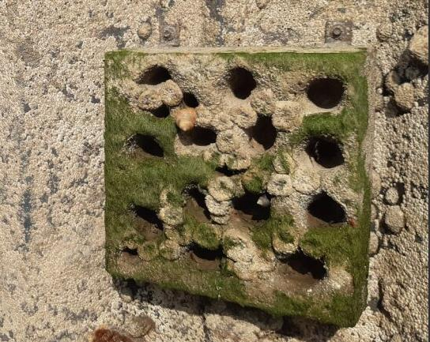
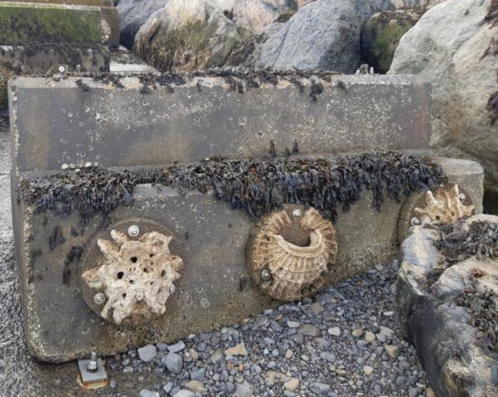
Design a Better Habitat
Activity 2
You are going to design your own ecological enhancement. Before you do, let’s have a look at some of the wonderful examples made by the Concrete Coast project.

Slide 20


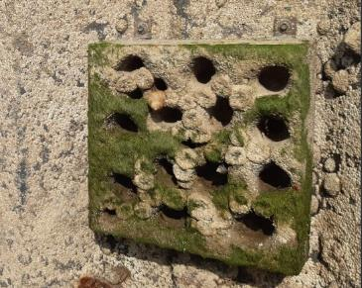
Design a Better Habitat
Once the designs are finished, allow the children to move around the room to share their design ideas.
Did you find a design that you think would help the most creatures?
What’s the most important things habitats need?
Can humans and nature work together?

Slide 21
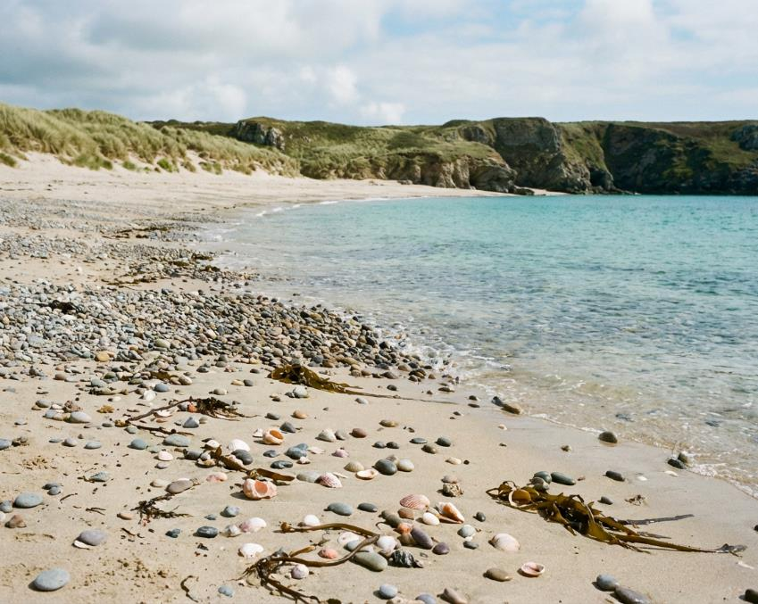
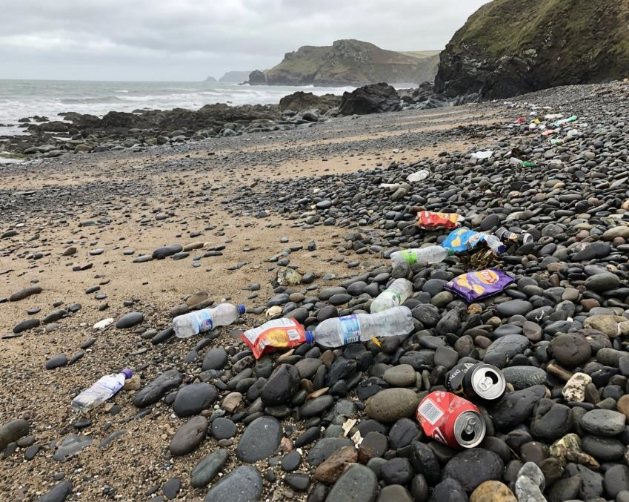
Human Impacts
Lesson 4
What’s different about these two beaches?

Slide 22
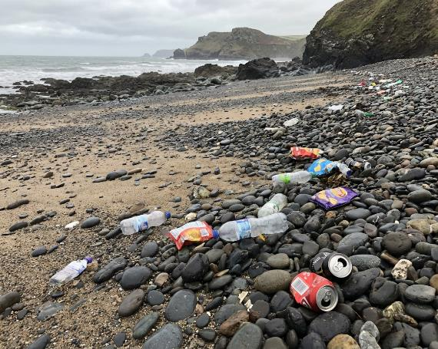
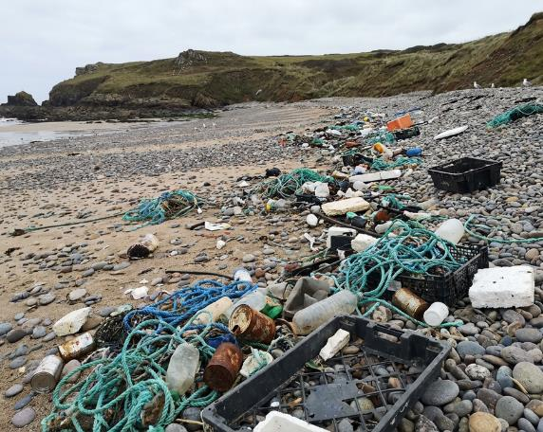
Human Impacts
Where does litter come from?
Have you seen litter on a beach?
What was it and how did it make you feel?
How might litter affect the creatures living here?

Slide 23
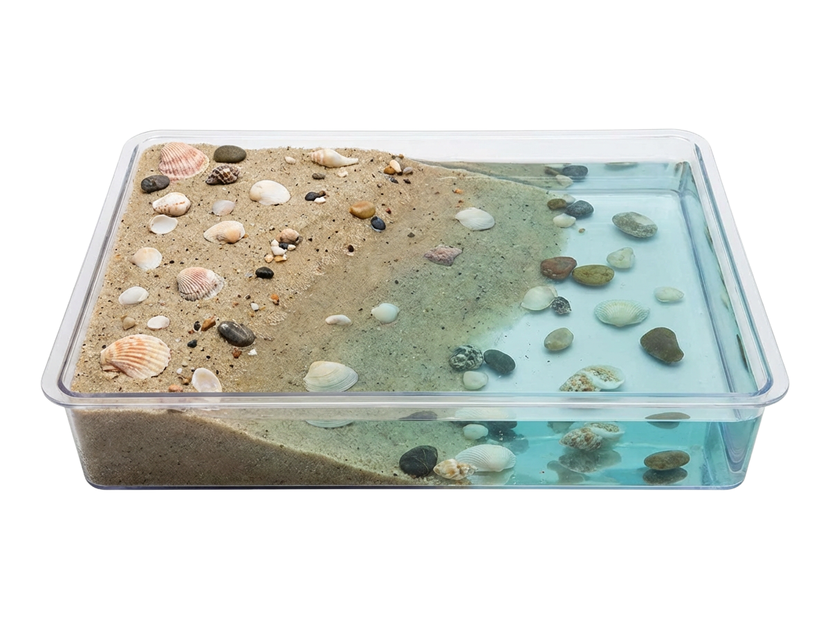
Pollution Investigation
In groups, make a model of a seaside inside a tray.

Slide 24
Pollution Investigation
Now, let’s add some pollutants to our beach and sea
What could we add?
How could they affect
the habitat and creatures
that live here?

Slide 25
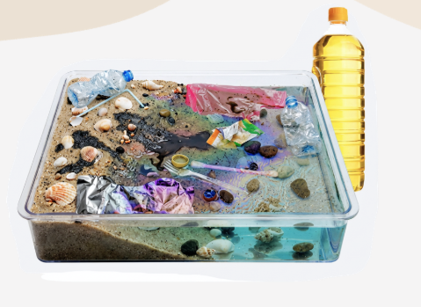
Pollution Investigation
What has happened...
What will be affected
the most?
How can we clean it up?

Slide 26
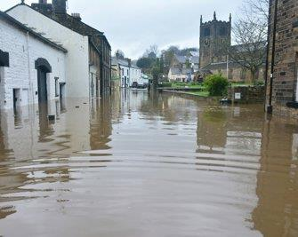
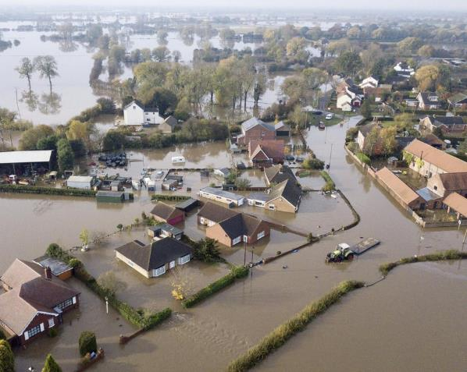
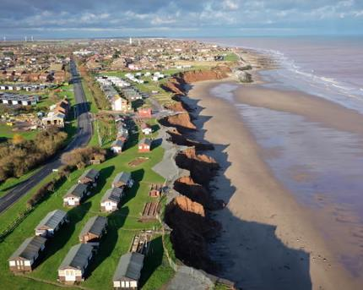
Climate Change
Lesson 4
What has happened in these pictures?
Why is the sea level rising?
How does this affect the creatures living here?

Slide 27
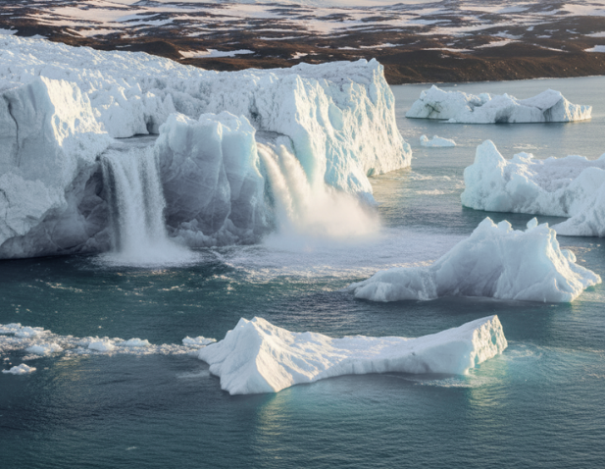
Climate Change
read together
Our Changing Coasts
The sea is getting higher! This is called rising sea levels. When the sea gets higher, it can cover more of the beach and reach further up onto the land.
Why is the sea rising?
The Earth is getting warmer (this is called
climate change)
  When ice at the North and South Pole melts, it it makes more water in the sea.
  Warmer water takes up more space, so the
sea level rises.

Slide 28




Climate Change
read together
What happens when the sea level rises?
  Beaches get smaller.
  Animals that live on the beach have less space for their homes.
  Sea water can flood towns and villages near the coast.
  Cliffs can fall into the sea more easily.

Slide 29






Coastal Squeeze
Let’s have a go at the investigation in our workbooks to help us understand what is meant by ‘coastal squeeze’ and how the Concrete Coast project are making a difference!

Slide 30




Reflection
We've explored the Concrete Coast project; a real-life mission protecting our Yorkshire coast.
We learned how the team is tackling a big challenge: our concrete sea defences keep us safe from flooding, but they're bare and lifeless.
That's where the eco-tiles come in. By attaching specially designed tiles to existing defences, the Concrete Coast Project is transforming hard concrete into thriving habitats for crabs, starfish, seaweed, and other coastal creatures.

Slide 31

Reflection
To end...
If you could meet the people working on the Concrete Coast project, what would you ask them?

